Slide 1
VIRGINIA LICENSING CEREMONY
Judge [Name]
[County Name] Juvenile District Court
Tuesday, January 24, 2017
Notes:
I want to welcome you to the Juvenile Domestic Relations Court in what I hope this is going to be your only visit! Today is an important day for both parents and teens.

Slide 2

Congratulations
Notes:
I want to start by saying: Congratulations on earning your driver’s license!
Teens, you have:
Held your learner’s permit for 9 months
Completed a driver’s education program
Practiced under supervision for 45 hours (15 hours at night)
Convinced your parent to bring you here today ☺
You’ve checked all the necessary boxes and now you’re ready to drive independently. But with this new permission to drive independently comes a huge amount of risk! *press next*

Slide 3
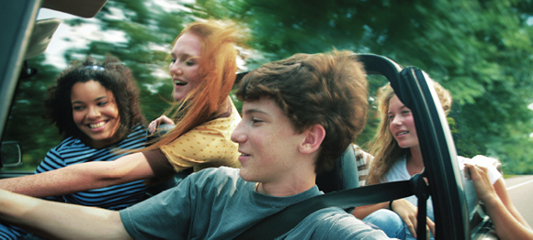
Driving is risky for everyone
However, teen drivers have especially high crash risk
Notes:
Driving is risky for everyone, at every age, but teens drivers have especially high crash risk.
Compared to adult drivers, teens are more than twice as likely to be involved in a fatal crash.
The main difference between young drivers and old drivers is experience. Teens are still new to driving and haven’t fully developed the skills needed to manage everything associated with driving.
As with any new skill, it takes practice to become experienced. When a toddler is learning how to walk, they are going to fall many times before they master the skill of walking. But with driving, the consequences of a mistake can be much greater than a scraped knee.

Slide 4
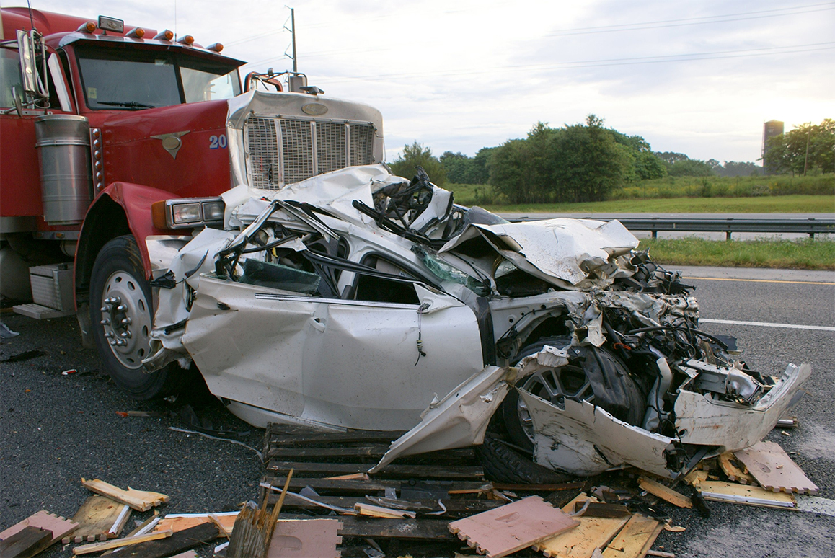
Leading causes of death for 12-19 year olds in the U.S.
Car Crashes
35%
Homicide
13%
Suicide
11%
Cancer
6%
Other Unintentional Death
5%
Notes:
Motor vehicle crashes are the leading cause of death for teens in the U.S. *press next* They consistently rank above all other causes of death for teens.
1 in 5 16 year-old drivers have an accident within their first year of driving.

Slide 5
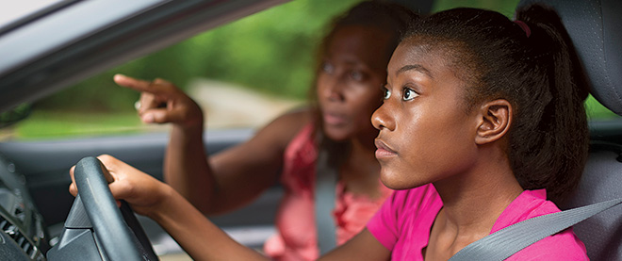
Parents can help reduce their teen’s driving risk
Notes:
The good news is that teens are on their way to becoming experienced drivers!
Parents, you might be thinking – ok, so I know that this is one of the riskiest moments in my child’s life, but…
What creates more risk for my teen?
What has been shown to reduce risk for my teen?
What can parents do?
*press next*
Parents can help teens gain independent driving experience in the safest conditions & gradually introduce them to riskier conditions as they become more experienced.
A good example is night driving. The VA state curfew for teens is midnight, but it gets dark much earlier than 12am. To help teens gain experience in night driving gradually, parents could set the curfew at 9pm for the first 3 months of driving. After 3 months, if the teen has demonstrated good driving behavior, the parents can extend the curfew to 10pm. 3 months later the curfew could be extended again to 11pm.

Slide 6
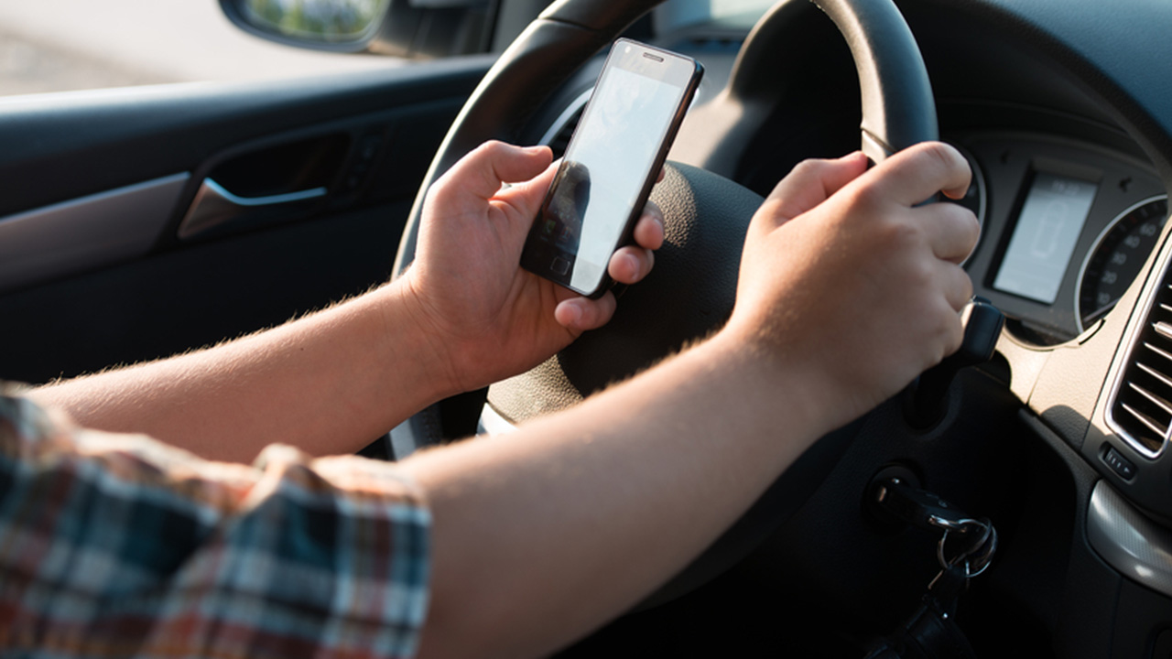
Presentation goals
Identify conditions that increase risk for new drivers
Discuss ways to minimize risk for new drivers
Notes:
In this presentation, we want to help identify conditions that increase risk for teen drivers and how to minimize that risk.
The information presented isn’t based on opinion or scare-tactics. All of the information in this presentation is backed by research.

Slide 7
What are the greatest risk factors associated with teen driving?
Notes:
What are the greatest risk factors associated with teen driving?

Slide 8
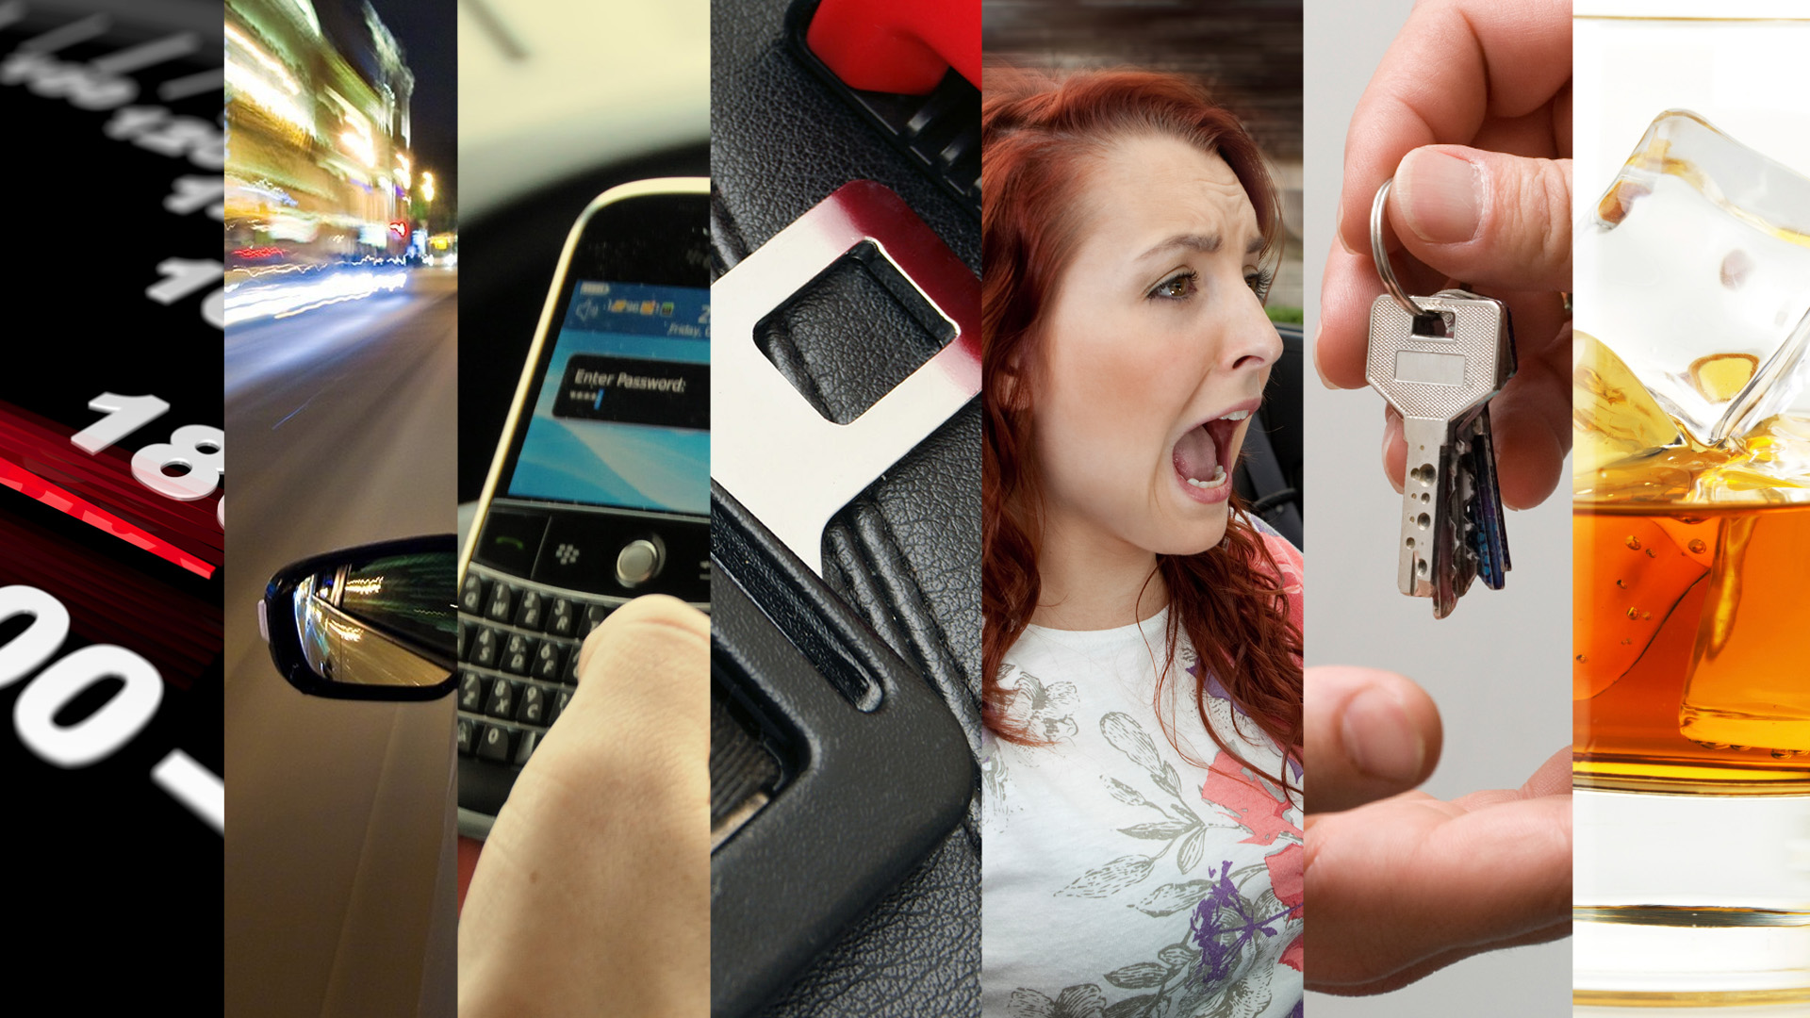
passengers
primary access to vehicle
impaired driving
night driving
distracted
driving
seatbelt non-use
speeding
Notes:
There are 7 major risks that teen driver’s face. *press next 7 times and state each risk*
I am going to discuss each of these risks and provide research on their risk.
You will see that when one risk is introduced, the likelihood of another occurring is often higher and the situation riskier.

Slide 9

Braking at 60 mph
---------------------240 feet----------------------->
--------------------5 seconds---------------------->
STOP
-----------------18 car lengths------------------->
Speeding
Notes:
Let’s start with speeding.
A third of all fatal teen crashes are speeding related
While some risky behaviors may decrease overtime, naturalistic driving studies have shown that teens’ speeding behavior has a tendency to increase over time, possibly due to confidence.
There is evidence that teens speed more at night and in the presence of peers.
Speeding is dangerous because it reduces the time you have to respond. *press next*
If you have to slam on your brakes at 60 mph it will take 5 seconds to stop and in that time you travel 240 feet.
It’s also dangerous because the faster you go, the harder the impact of the crash, and the greater risk of death or injury.

Slide 10

Driving at Night
Notes:
While only 25% of teens’ driving is at night, 41% of fatal teen crashes occur at night.
16 & 17 year old drivers are 3 times more likely to be involved in a fatal crash at night than 30-59 year olds.
Night driving is dangerous because obstacles in the roadway are not easily visible, as your headlights only illuminate a few seconds ahead of you.
Also, we have a tendency to become drowsy at night.

Slide 11
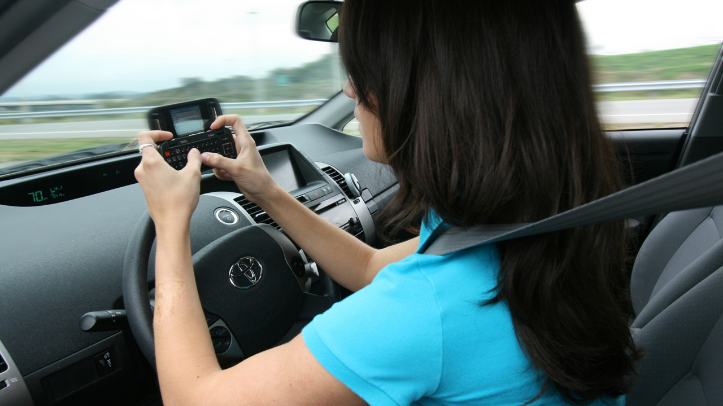
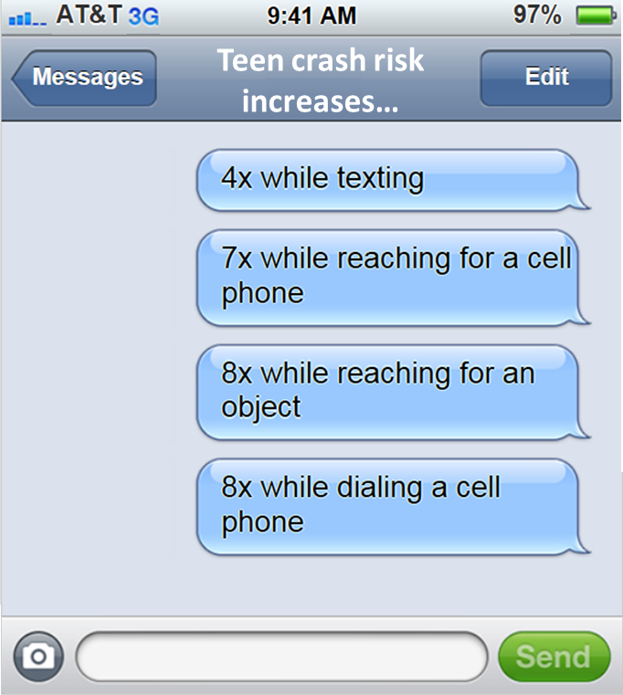
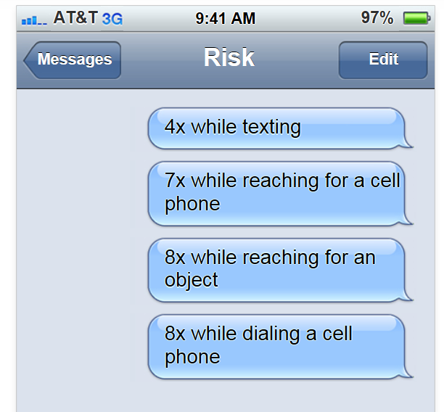
Distracted Driving
Notes:
Between 2007-2011, 16-24 year old drivers used hand-held devices more than any other age group.
*press next*
Novice driver crash or near crash risk is increased:
*press next* 4x while texting
*press next* 7x while reaching for a cell phone
*press next* 8x while reaching for an object
*press next* 8x while dialing a cell phone
Distracted driving takes your eyes off the road. Crashes happen in a matter of seconds!
When you aren’t looking forward, you are missing potential hazards and cannot respond quickly.

Slide 12
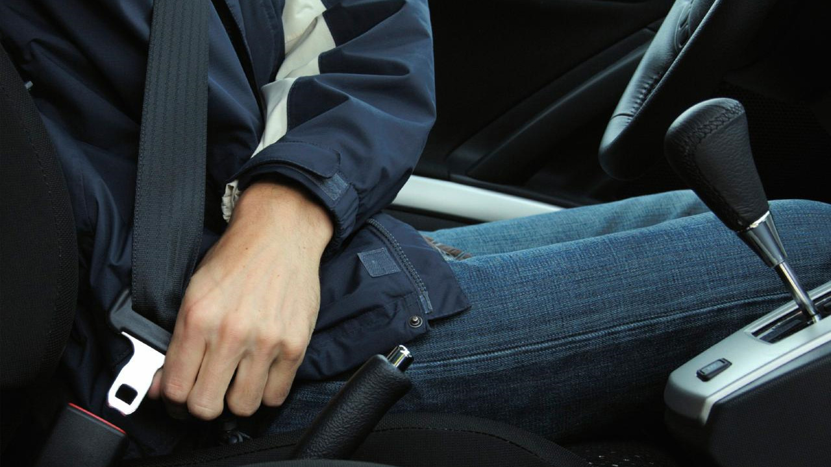
Seatbelt Non-use
Notes:
The next risk is seatbelt non-use.
Seat belts reduce serious crash-related injuries and deaths by about half!
55% of US high school students reported they always wear seat belts when riding with someone else.
7.6% of US high school students reported they never wear seat belts when riding with someone else.

Slide 13
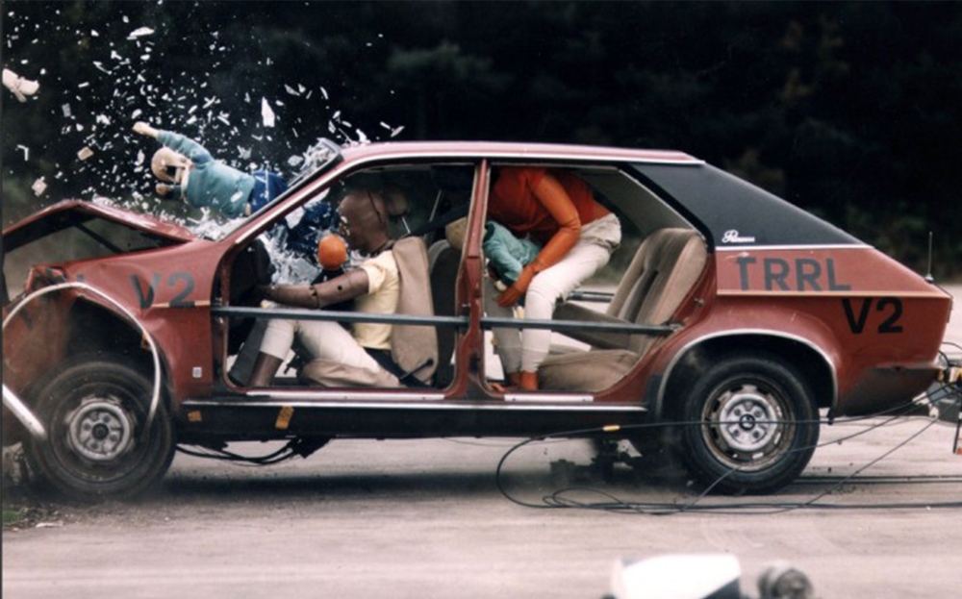
Notes:
58% of teen drivers killed in crashes were not wearing a seat belt
50% of teen passengers killed in crashes involving a teen driver were not buckled up
You never know when you are going to get in accident so you should ALWAYS wear a seatbelt.

Slide 14
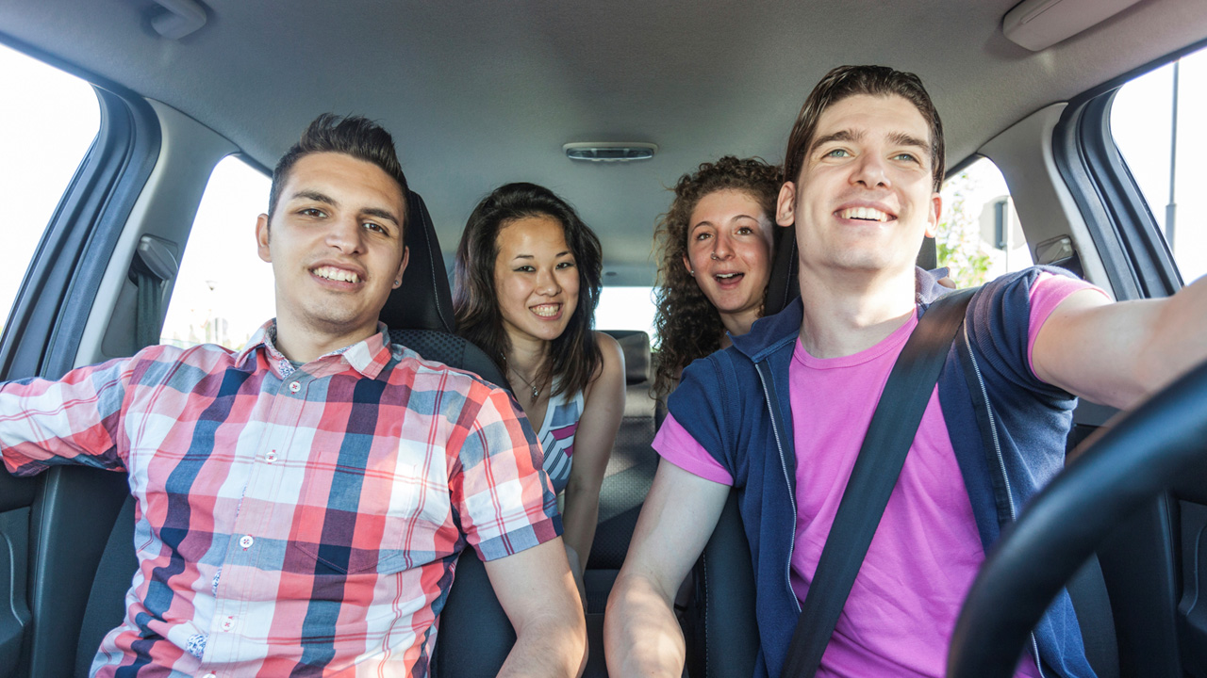
Presence of Teen Passengers
Notes:
For teens, each additional passenger, the risk of a driver fatality is increased
42% of fatal crashes of 16 & 17 year old drivers involved teens transporting teen.
The presence of peers can create a distraction and increases teens’ tendency to take risks.
Rates of risky driving behaviors are especially high among teens with risky friends.

Slide 15

Primary Access
to a Vehicle
Notes:
What is primary access? the teen is the main driver of the vehicle.
Teens who have primary access to a vehicle:
have higher crash risk than teens who share a vehicle.
are more likely to speed.
use cell phones more often while driving
are more likely to drive smaller, older vehicles, despite the fact that these vehicles are substandard in crash protection.
Cars often get passed down in the family and it might make sense for your family to have an old beat-up car for the teen to drive. And not everyone can afford new vehicles with state-of-the-art crash protection, but consider just how safe that old car is when you hand it off to the teen. If you’re thinking about buying your teen an old used car so they don’t damage your newer car, consider having them share your safer car instead.

Slide 16
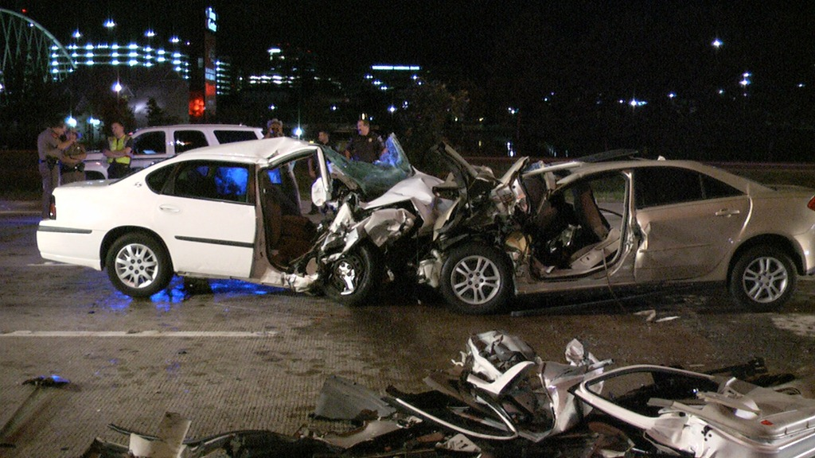
Impaired Driving
Notes:
Good News ☺
Alcohol-related fatalities involving teens has reduced over the past decade. From 2002-2011, fatalities from crashes involving young drivers and alcohol it decreased by 57%!
Bad News ☹
In 2011, 32% of young drivers who were killed in crashes had a BAC of .01 or higher; 26% had a BAC of .08 or higher.
Teens cannot purchase alcohol on their own, so someone is giving them access. These are preventable deaths.

Slide 17
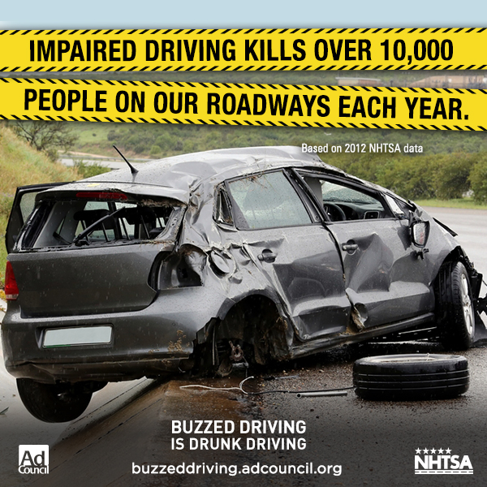

Slide 18

Reducing the Risks
Notes:
So what has been shown to reduce teen driving risk?

Slide 19
Graduated Driver’s Licensing (GDL)
1) Learner Stage:
2) Intermediate Stage:
3) Full Privilege Stage:
Minimum age:
  15 years & 6 months
Supervised driving:
  45 hours (15 at night)
Pass Driver’s Ed
Duration:
  At least 9 months
Minimum age:
  16 years & 3 months
Limited unsupervised driving in high-risk conditions
Minimum age:
  18 years
Notes:
Since 1995, states across the U.S. have adopted some form of Graduated Driver’s Licensing. *press next* I will be calling this GDL from here on out.
What this means is that there are laws in place that have new teen drivers go through stages before they receive their “full privilege” license.
In Virginia, there are 3 driver’s licensing phases: *press next* the Learner’s stage *press next* the Intermediate stage and *press next* the Full privilege stage.
Your teen has successfully completed the Learner Stage and will remain in the intermediate stage with their provisional license until they are 18. Let’s discuss the GDL and other driving laws that apply to them.

Slide 20
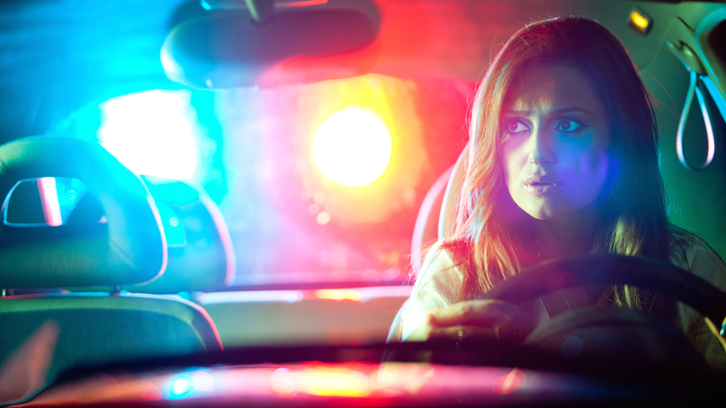


Driving laws for licensed drivers under 18
Night driving:
Cell Phone Use:
Teen Passengers:
First year
of licensure:
All cell phone use is illegal
After 1 year of licensure:
No driving between 12am and 4am
Alcohol Use:
  Zero tolerance
  Driving with any alcohol in your system is illegal
Notes:
*press next*
First, night driving is restricted. Teens are not allowed to drive between the hours 12am and 4am.
*press next*
Second is cell phone use: Talking and texting are illegal for teens. Texting is now a primary offense for teens.
*press next*
During the first year of licensure, no more than 1 passenger under 21 is allowed. After 1 year of licensure, no more than 3 passengers under 21 are allowed. The only exception to this rule is close relatives.
*press next*
If you are under the legal drinking age of 21 there is zero tolerance for driving under the influence! It doesn’t matter if you blow a .02 BAC, driving with any alcohol in your system is illegal. If you are convicted of a DUI, the court will suspend your license for one year and a minimum mandatory fine of $500 or the 50 hours of community service will be given.
It’s important to know the law and enforce it with your kids. They are still learning to drive and these restrictions are meant to protect them.

Slide 21
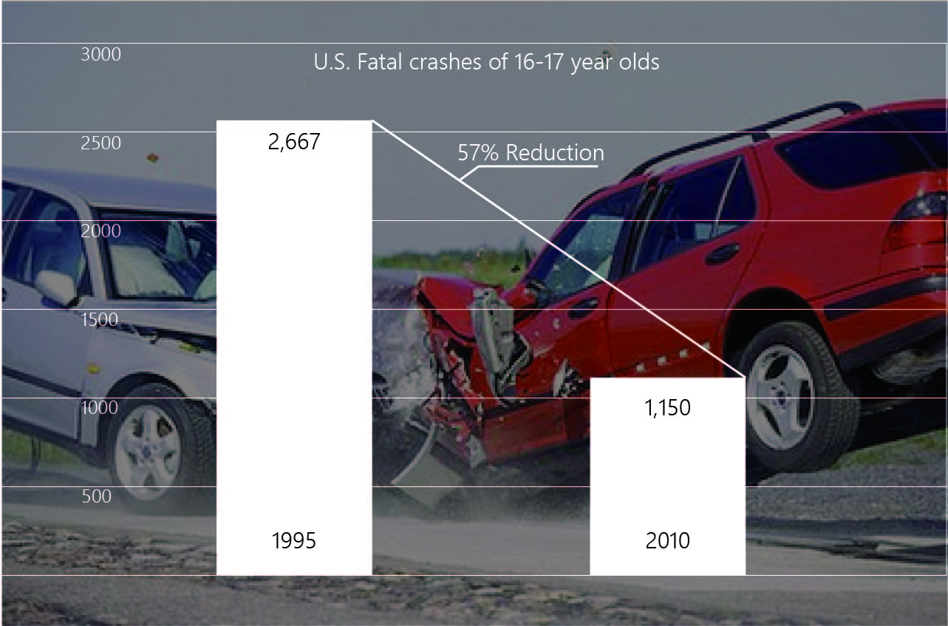
Notes:
Since the introduction of GDL in 1995, fatal teen crashes have reduced by more than half! However, it is still a leading cause of death among teens
The greatest reductions for 16 year-olds occurred in nighttime crashes, alcohol-related fatal crashes, and fatal crashes involving multiple teenage passengers. These are the risks that GDL laws target! And I’ll add that these laws are working because parents are enforcing them on their kids.
While GDL has helped, there is still more to be done. Car accidents are consistently the number one cause of death for teens. Parental involvement is important to encourage teen’s safety and driving improvement.

Slide 22
Age: 15-19 | 2010 | 2011 | 2012 | 2013 | 2014
Injuries | 13218 | 13890 | 14283 | 13366 | 12579
Fatalities | 109 | 101 | 114 | 96 | 75
Source: Virginia Department of Motor vehicles
Notes:
Injury and fatality statistics for the state of Virginia. Note that the numbers are going down over time. We still have further to go!

Slide 23

Parental influence
Notes:
After teens check all the boxes in the learner’s stage and are able to drive independently, it may seem best to just let your teen drive as often as possible in all conditions. The more experience they get, the more their driving will improve! However, parental involvement post-licensure is critical in reducing crash involvement. GDL and other driving laws are in place to reduce exposure to risky conditions, but these should be viewed as the ‘minimum’ for parents.
Research shows that parents tend to underestimate their teens risky behaviors. Studies where parents and teens state the driving restrictions in their family, their teens often report a much lower level of restriction.
One tool parents should consider is a Parent-Teen Driving Agreement.

Slide 24
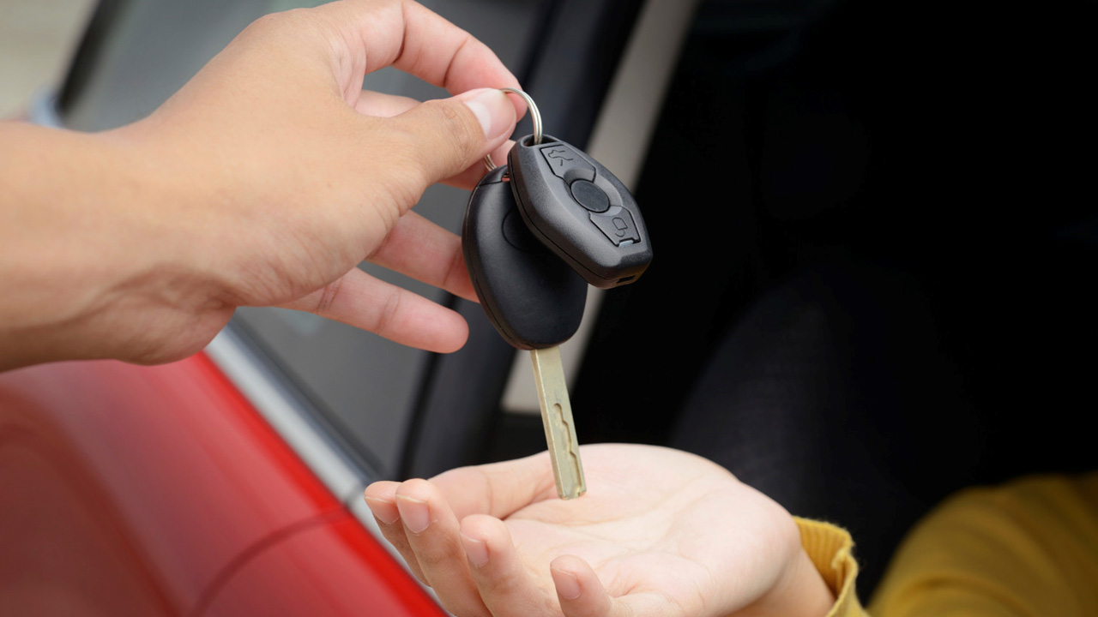
Parent-Teen Driving
Agreements (PTDAs)
Notes:
Parent-Teen Driving Agreements are basically an extended, family-level GDL.
Studies have shown that when teens and parents disagree on parent-imposed driving restrictions, there is more high-risk driving in teens.
By using a PTDA, parents and teens have the opportunity to define expectations early and work together on driving agreement customized to their family’s needs, potentially reducing disagreement in driving restrictions. A PTDA rewards teens with additional privileges after good driving behavior over time.
Checkpoints has been the most extensively studied and research-supported PTDA. It was developed through the National Institute of Child Health & Human Development. I am going to show you an example of what the Checkpoints GDL looks like.

Slide 25
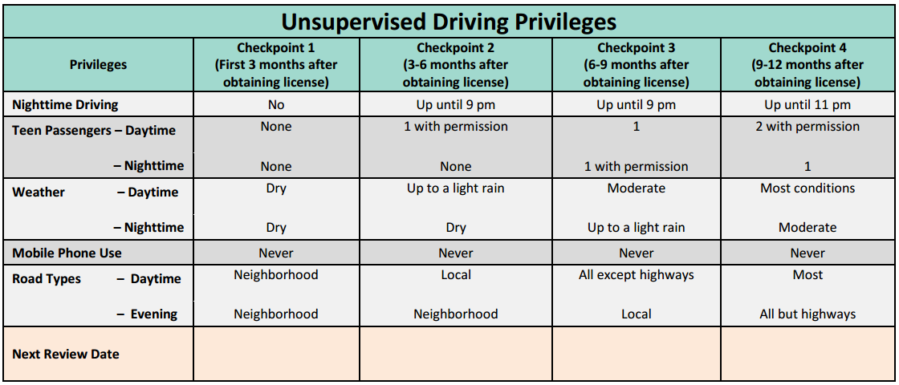
Notes:
First, outline Unsupervised Driving Privileges.
Risky driving conditions such as night driving, passengers, and weather are listed on the left. *press next*
The first checkpoint lasts 3 months after the teen starts driving independently. The example here limits teens driving in these conditions. After 3 months, the agreement will be reviewed and if conditions have been met *press next* teens advance to the next checkpoint and are allowed more driving privileges.
The limits here are suggestions and you can alter them to meet your family’s needs. Just make sure passenger limits and night driving limits stay with Virginia State Law.

Slide 26
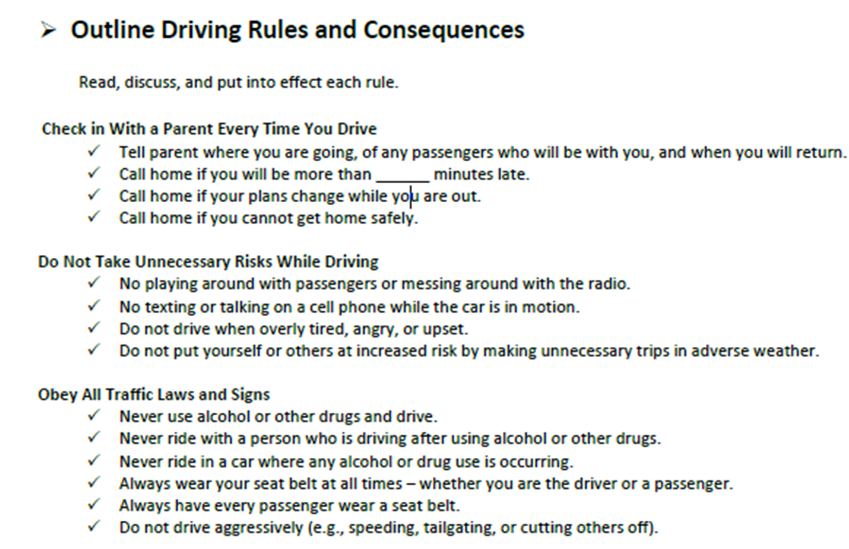
Notes:
Then, outline driving rules and consequences. This PTDA has checking in with parents, don’t take unnecessary risks, and obey the law
Resources
http://www.youngdriverparenting.org/

Slide 27
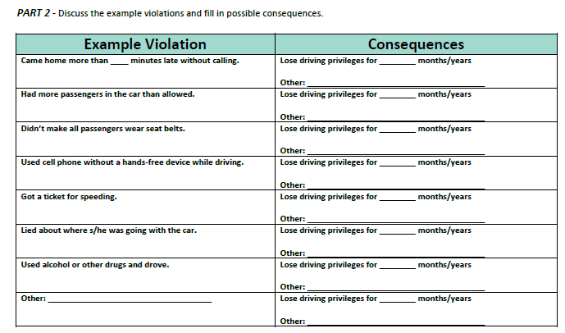
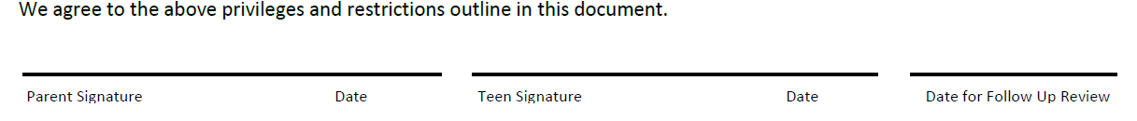
Notes:
Next, discuss example violations and possible consequences. This way there aren’t any surprise consequences down the road and teens know what to expect if they are unsafe drivers.
And finally *press next*, the parent and teen each sign the agreement.

Slide 28
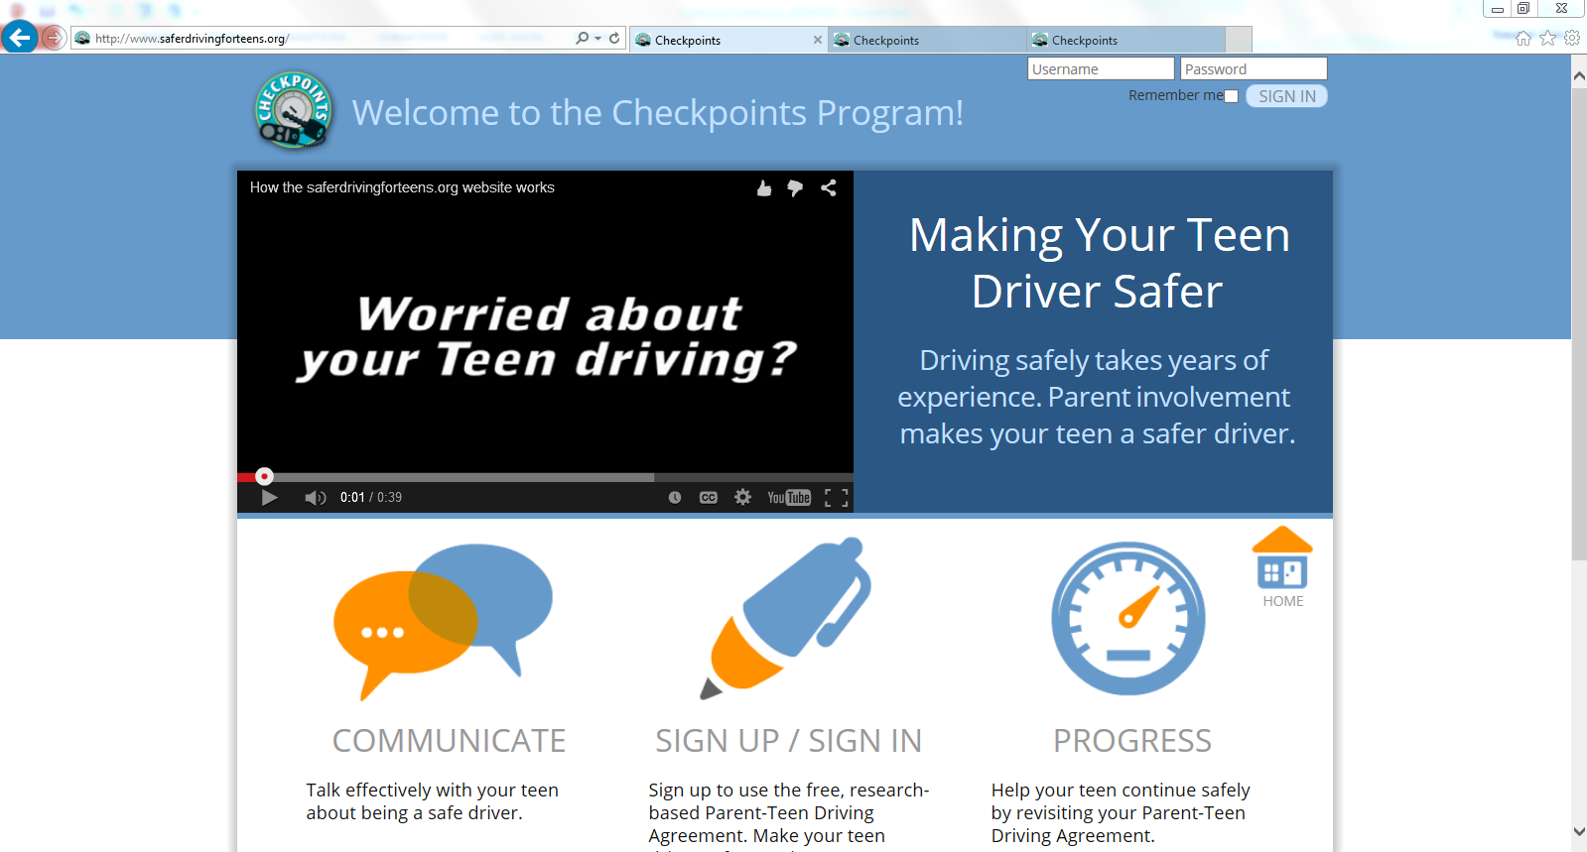
Notes:
Checkpoints also created a website to keep track of your PTDA. The address is safedrivingforteens.org.
There are videos about how to use Checkpoints, as well as email reminders at the end of each Checkpoint.

Slide 29
Teen driving risks:
  Speeding
  Night Driving
  Distracted Driving
  Seatbelt Non-use
  Passengers
  Primary Access to a Vehicle
  Impaired
Minimize the risks:
Passengers
Keep driving with your teens after licensure.
Have your teen share a vehicle with you and other family members.
Create a family-level Graduated Driver’s Licensing system
Enforce the minimum Virginia driving laws with your teen.
Notes:
To review, here are the major teen driving risks. *press next*
These risks have been researched extensively and it’s clear that these are the biggest risks your teen faces while driving
And let’s review how parents can reduce that risk *press next*
Enforce the minimum Virginia driving laws with your teen.
This means having them buckle up EVERY time. This means having them home before midnight. This means NOT allowing alcohol use or cell phone use in the car.
2) Create a family-level Graduated Driver’s Licensing system
Again, graduated driver’s licensing just means gradually introducing your teen to risky driving situations over time. Discuss driving privileges, rules, and consequences at the beginning of independent driving.
3) Have your teen share a vehicle with you and/or other family members. I understand that with different schedules and convenience, it really might be unrealistic for you family to share a vehicle. But what is the policy with your teen? Can they grab the keys and vehicle whenever they want or do they need to ask you first? If you have them ask you for the keys every time before they get in that car, then the car won’t feel like something they are entitled to but rather something they earn. And this is something you can include in you PTDA. Maybe for the first year they have to ask every time, but after that they don’t. The great thing about the PTDA is that it allows teens to be rewarded and to earn driving privileges when they show they deserve them.
4) Passengers - Sometimes it can save time or gas to have teens carpool and can seem harmless. Talk with your teen’s friends’ parents about having your kids drive separately. Make it a part of the conversation.
5) Keep driving with your teens after licensure. When observing teens after they get their license, their risky driving was 67% lower with adults in the car. That is HUGE. This could be for a variety of reasons – maybe they are more focused with adults present, maybe they are getting advice from adults as they drive. But regardless, supervision does NOT need to stop after licensure! If you’re teen wants to go to the store and the weather is poor, instead of just driving for them drive WITH them. They’ll have to drive alone in bad weather at some point, so why not help them continue gaining experience with your guidance.

Slide 30
Notes:
The bottom line is that parent’s need to continue their involvement. It’s not too late to get involved with your teen’s driving.
Parents underestimate their teen’s risky behaviors. It’s not about if you have a “good” kid or a “bad” kid. You might think my kid wouldn’t do that, my kid is better that that. But these driving risks apply to ALL teens.
Parents, this is about you saving your child’s life. You have to opportunity to do that.

